Slide 1


NCAA Basketball Win Rates
Conor Juengst
Lan Nguyen
Prof. Lin
Statistics 510
Fall 2014
Notes:
Conor

Slide 2

Background/Intent
To build a multiple linear regression model for men’s Division 1 college basketball using data from http://www.sports-reference.com/.
We will be using a team’s Win-Loss percentage as the response variable, which is the proportion of games that a team won in the 2013-14 season.
Our model will use box score statistics (FG%, rebounds, steals, etc) along with strength of schedule information from sports-reference as our predictors.
Is there a linear relationship between Win-Loss percentage and the other variables from our data set?
Notes:
Conor/Lan

Slide 3
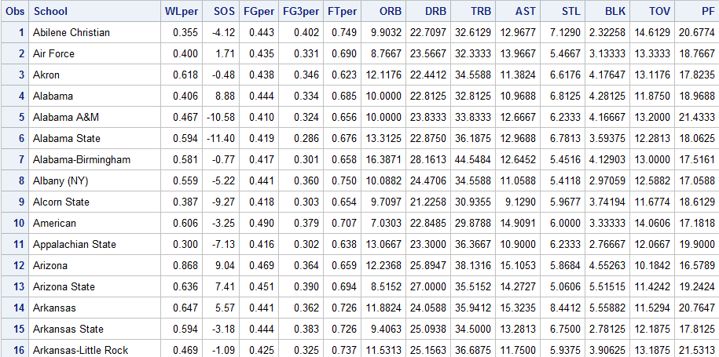
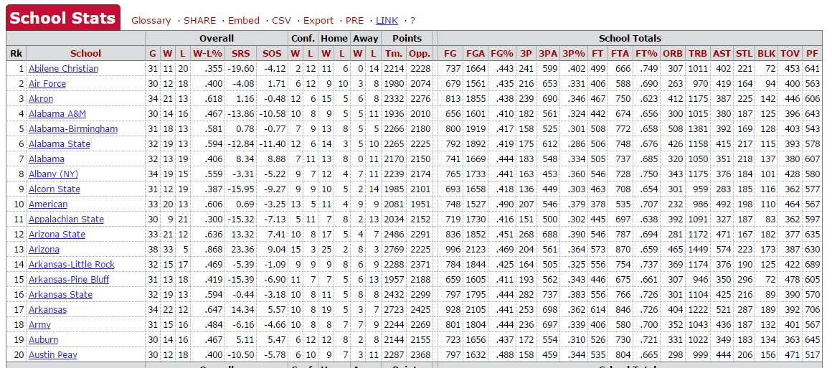
2013-14 Data
Raw data from 351 schools nationwide
Narrowed to 12 predictor variables
Used data from ‘School Totals’ section and included Strength of Schedule
Discrete values turned into averages
Data exported as .csv from http://www.sports-reference.com/cbb/
Notes:
Lan
can’t use conference data because directly related to W/L

Slide 4

Strength of Schedule
As defined by http://www.sports-reference.com/cbb/about/glossary
Notes:
Conor

Slide 5
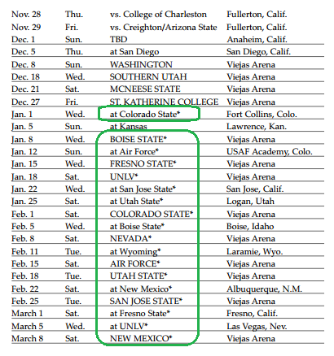

Strength of Schedule Cont’d
Also note that each team has control over who they play in the non-conference portion of their schedule
Notes:
Conor

Slide 6
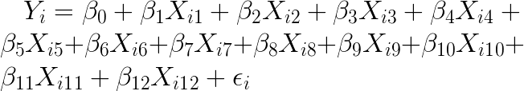
Hypothesis
Y | 1 | 2 | 3 | 4 | 5 | 6 | 7 | 8 | 9 | 10 | 11 | 12
WL% | SOS | FG% | 3% | FT% | ORB | DRB | TRB | AST | STL | BLK | TOV | PF
Notes:
Conor
SOS FGper thrper FTper ORB DRB TRB AST STL BLK TOV PF
http://www.codecogs.com/latex/eqneditor.php
WinPct = \beta_0 + \beta_1FG + \beta_2THR + \beta_3FT + \beta_4ORB + \beta_5DRB + \beta_6TRB + \beta_7AST + \beta_8STL + \beta_9BLK + \beta_10TOV + \beta_1_1PF + error
Y_i = \beta_0 + \beta_1X_i_1 + \beta_2X_i_2 + \beta_X_i_3 + \beta_4X_i_4 + \beta_5X_i_5 + \beta_6X_i_6 + \beta_7X_i_7 + \beta_8X_i_8 + \beta_9X_i_9 + \beta_10X_i_1_0 + \beta_1_1X_i_1_1 + \beta_1_2X_i_1_2 + \epsilon_i
H_o:\beta_0 = \beta_1 =...=\beta_1_2 = 0
H_a: not\;all\; \beta_i = 0

Slide 7
Assumptions
Predictor variables are linearly independent (can’t be expressed as a linear combination of other predictors)
Predictor variables have a linear relationship with our response variable
Error terms are uncorrelated, have a mean of 0, and constant variance
Notes:
Conor

Slide 8
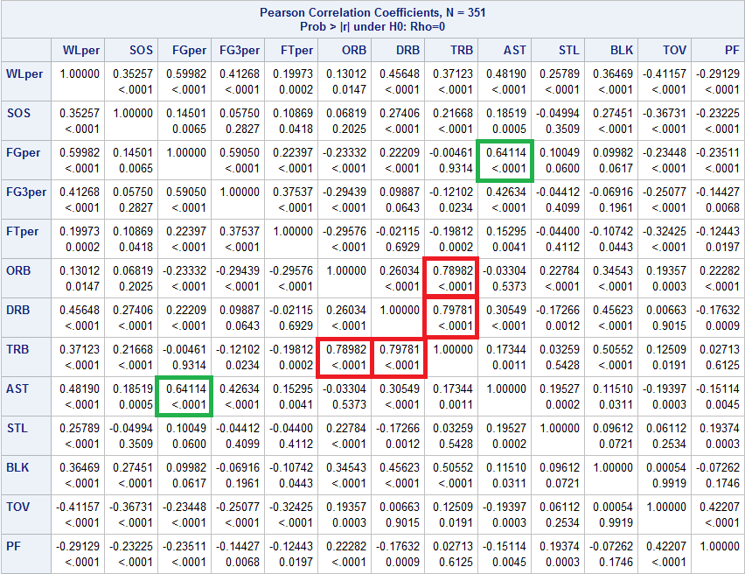
Correlation Analysis
Notes:
Lan
TRB has a high colinearity with ORB and DRB
AST colinear with FGper -

Slide 9
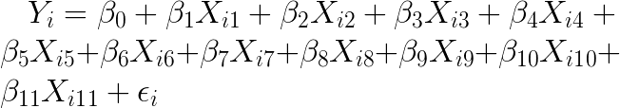
Revised Hypothesis
Y | 1 | 2 | 3 | 4 | 5 | 6 | 7 | 8 | 9 | 10 | 11
WL% | SOS | FG% | 3% | FT% | ORB | DRB | AST | STL | BLK | TOV | PF
Notes:
Lan
Removed TRB - violates our first assumption. lin combination
FGper thrper FTper ORB DRB TRB AST STL BLK TOV PF
http://www.codecogs.com/latex/eqneditor.php
WinPct = \beta_0 + \beta_1FG + \beta_2THR + \beta_3FT + \beta_4ORB + \beta_5DRB + \beta_6TRB + \beta_7AST + \beta_8STL + \beta_9BLK + \beta_10TOV + \beta_1_1PF + error
Y_i = \beta_0 + \beta_1X_i_1 + \beta_2X_i_2 + \beta_X_i_3 + \beta_4X_i_4 + \beta_5X_i_5 + \beta_6X_i_6 + \beta_7X_i_7 + \beta_8X_i_8 + \beta_9X_i_9 + \beta_10X_i_1_0 + \beta_1_1X_i_1_1 + \beta_1_2X_i_1_2 + \epsilon_i
H_o:\beta_0 = \beta_1 =...=\beta_1_2 = 0
H_a: not\;all\; \beta_i = 0

Slide 10
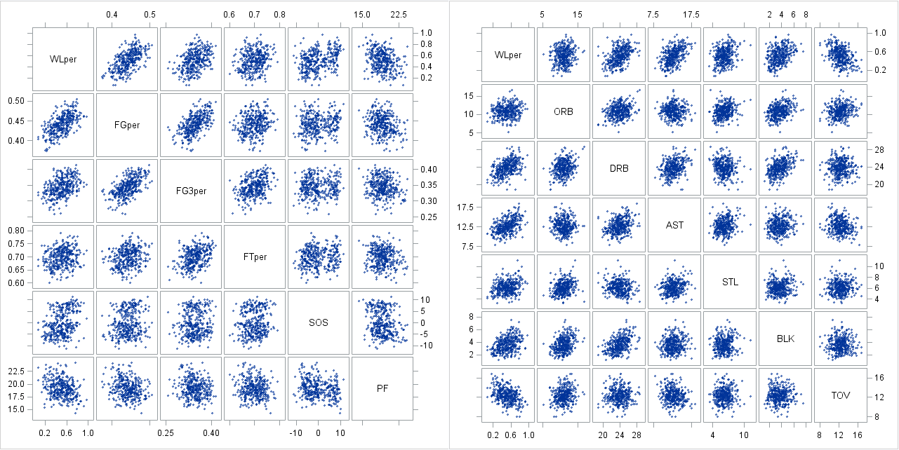
Initial Scatter Plots
Notes:
Lan
FT% not linear
ORB clustered due to small range
TOV was negative
Remaining predictors appear linear

Slide 11
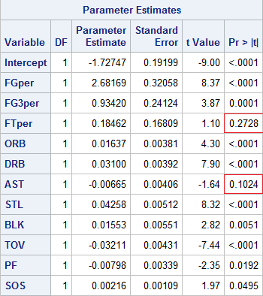
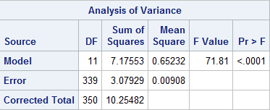

Regression Analysis (Full)
Notes:
Lan
p-value suggests that there is a linear relationship between w/l and predictor variables
r-sq: model accounts for about 70% of the data
however, the p-value for ft% shows that ft% is not statistically significant. This confirms our visual analysis of the initial scatter plots.

Slide 12
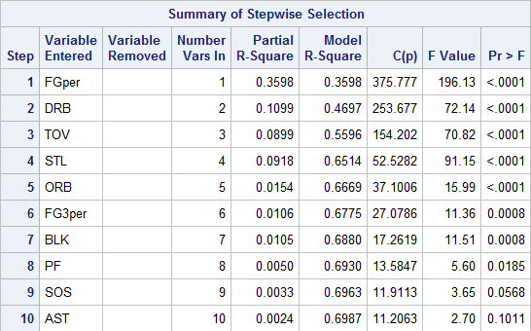
Selection Methods
Selection
Criteria:
p-value < α=0.15
Ideal C(p)=11
We chose the stepwise selection method to construct our reduced model
FT% is the only predictor to be excluded
Notes:
Conor

Slide 13
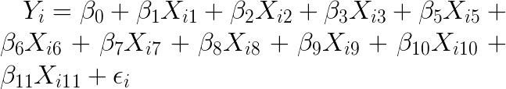
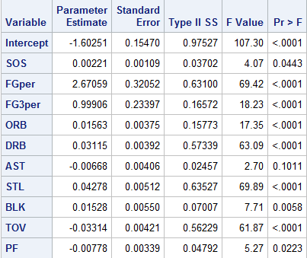
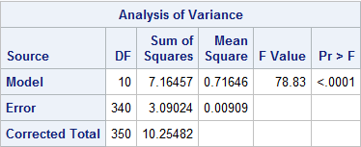
Reduced Model
R² = 0.6987
adjR² = 0.6898
C(p) = 11.2063
Notes:
Conor
SOS FGper thrper FTper ORB DRB TRB AST STL BLK TOV PF

Slide 14
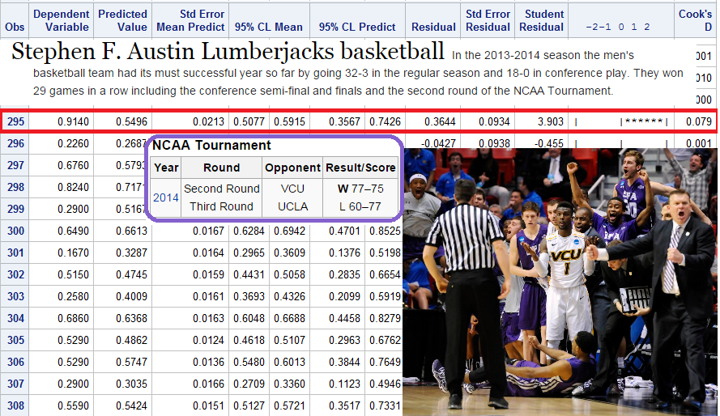
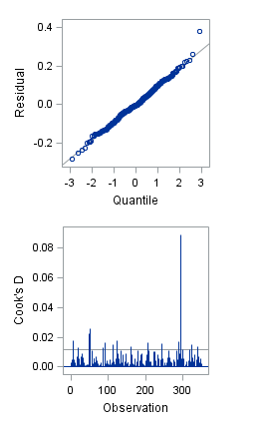
Outlier Analysis
Potential influential point
Notes:
Conor

Slide 15
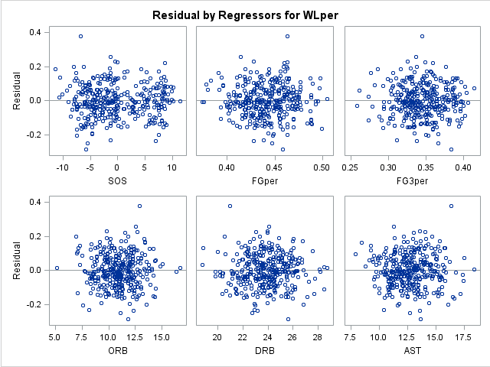
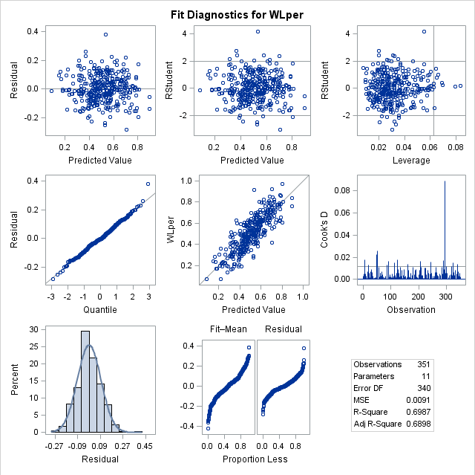
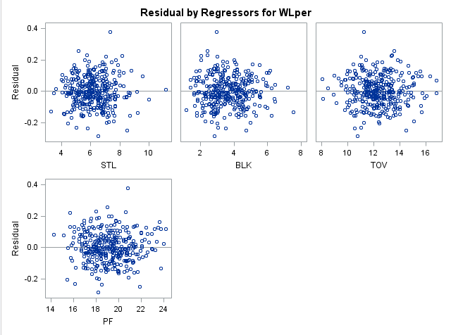
Checking Model Assumptions
Notes:
Lan
residual: means equals 0, constant variance, cooks distance,

Slide 16
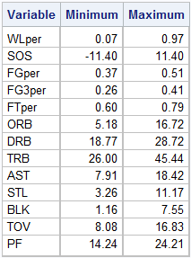
Conclusion
Our model produces a good estimate of W/L percentage for the 2013-14 season
Box score and SOS statistics display a linear relationship to W/L percentages with the exception of FT%
Notes:
Lan
For our estimate to be valid, all of our predictor variables must fall within the ranges determined by our data set

